Slide 1
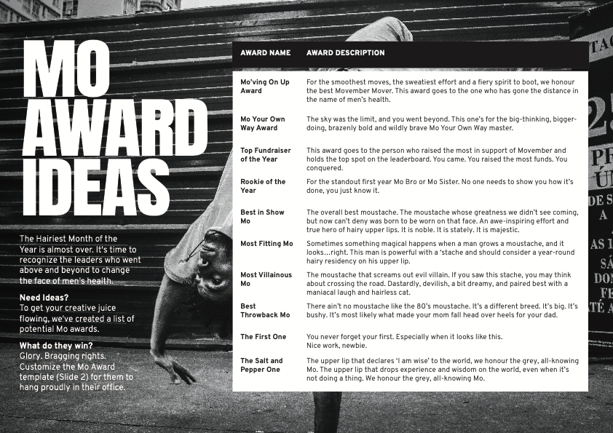

Slide 2
THE MOST CREATIVE MO
ANGELA MCMILLAN
You created a spectacular Mo for all to admire… out of nothing. While you didn’t technically grow one, you found a way to represent. Congratulations!

